Slide 1

Introduction to React

Slide 2
What is React
It is library for creating user interfaces
JavaScript framework for writing the web applications
Like AngularJS - Snappy response from running in browser
Less opinionated: only specifies rendering view and handling user interactions
Uses Model-View-Controller pattern
View constructed from Components using pattern
Optional, but commonly used HTML templating
Minimal server-side support dictated

Slide 3
Building Components not templates
Components are the building blocks of the React
Vey similar to Dircetives in Angular JS
You can thing of a components as a collection of HTML, CSS, JS.
Components can be written in pure Javascript or JSX.

Slide 4
ReactJs Web Application Page
<!doctype html>
<html>
<head>
<title>CS142 Example</title>
</head>
<body>
<div id="reactapp"></div>
<script src="./webpackOutput/reactApp.bundle.js"></script>
</body>
</html>
ReactJS applications come as a
JavaScript blob that will use the DOM
interface to write the view into the div.

Slide 5
Benefits from React
You avoid expensive DOM operations.
Minimize access to the DOM.
Update elements offline before inserting to the DOM.

Slide 6
React Virtual Dom
Re-render everything on every update?
It sounds expensive but it is not
React creates an in-memory data structure cache, computes the resulting differences. And then updates the browser’s displayed DOM efficiently
Create lightweight description of components UI
Diff it with old one
Compute minimal set of changes to apply to the Dom.

Slide 7

Project With the use of ReactJs
-REAL ESTATE

Slide 8
Overview of Website
Project is an website for a real estate agency allowing on one hand property owners to publish their real estate for sale or rent ,and on the other hand people to view these goods and to choose the ones that most suit their needs. This project includes several functions related to a real estate business. This website is designed in order to make the real process of buying and selling properties a little more handy and a little more easier .This saves much time of buyer as he/she can easily see properties without visiting them.

Slide 9
Functionality
The user can be able to register him/her-self on the portal entering the required credentials. Further the same credentials will be used in order to login to the portal. Home Page of our website includes the options of login/signup which is to be done in order to access the full fledge website. About section tells the user about the app and its creators. Contact section gives the user the details to contact the Admin of the website in order to sort any query or to register any complaints. The properties section opens up a new page in order to represent the various properties available for the user along with their details { No. Of bedrooms, No. Of bathrooms, Location, Price, for-(Rent/Sale) } which makes it easier for the user to select and buy any particular property according to his/her choice.

Slide 10
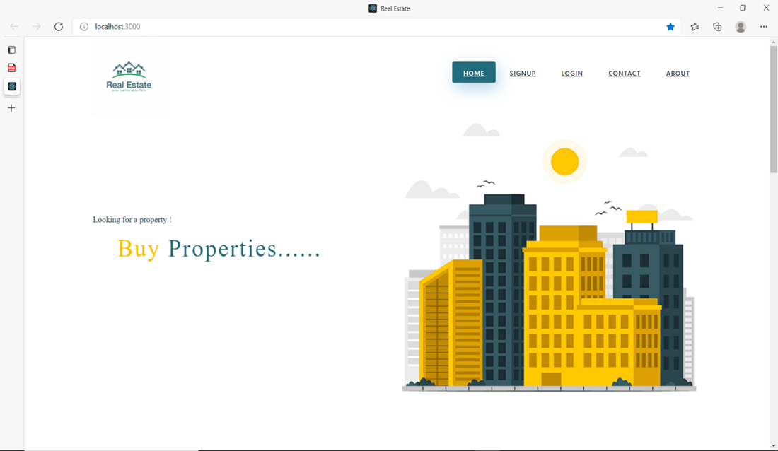
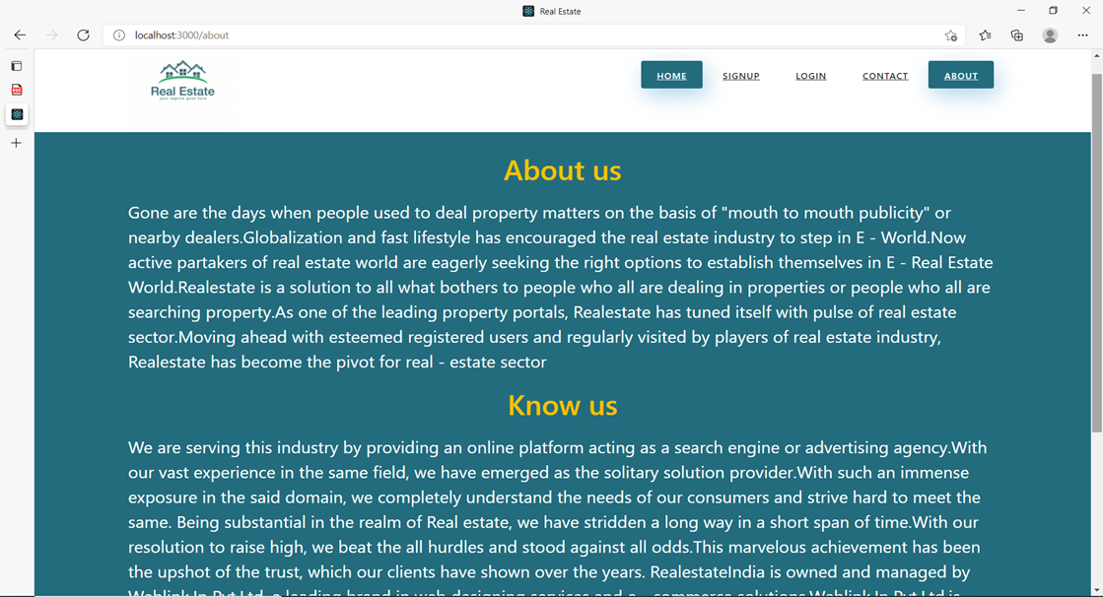
Home Page
About Page

Slide 11
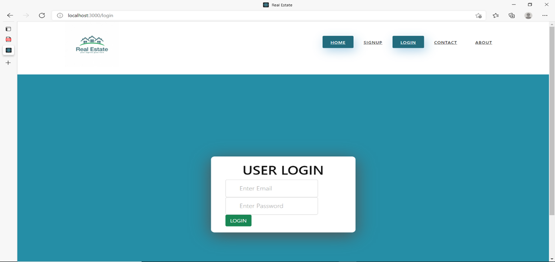
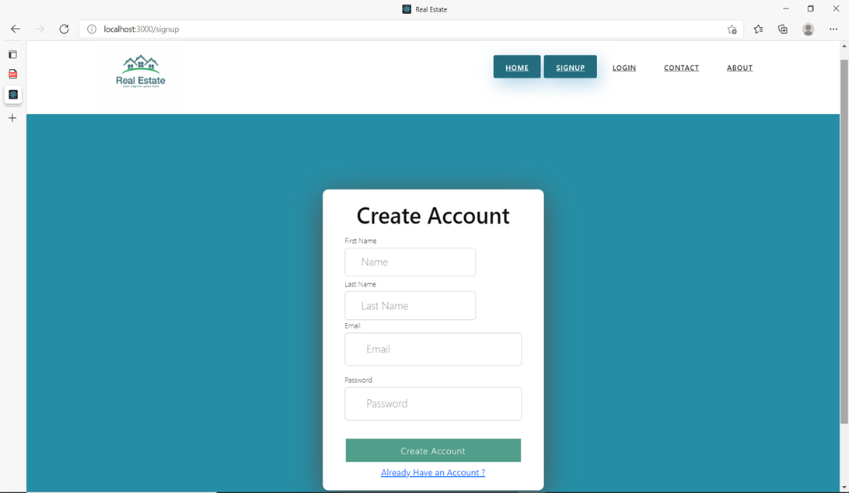
User Login Page
Create Account Page

Slide 12
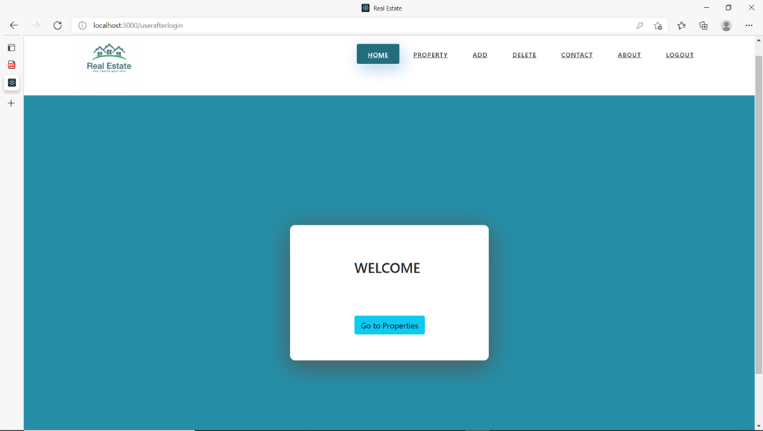
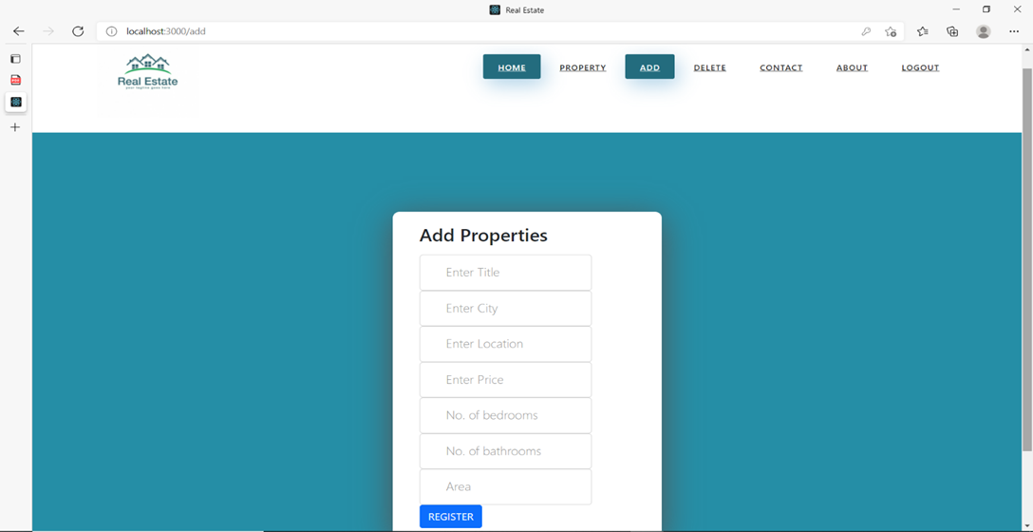
After Login Page
ADD Page

Slide 13
Thank
You…..

